Slide 1

UCLA
Masters of Quantitative Economics
ECON 412 Final Project
Alexander Ramos
Aneri Patel
Anshika Sharma
Cristian Martinez
ECON 412 Final Project: Bankruptcy Prediction

Slide 2
Contents
Introduction
Data Processing
Feature Selection
Machine Learning Models
Model Comparison
Summary
ECON 412 Final Project: Bankruptcy Prediction

Slide 3


Introduction
Classifying bankruptcy in Taiwanese Companies
Topic:
Objective:
1. Find the key indicators
2. Obtaining a model with high accuracy
Why matters?
Highly impactful to the economy
Predictive models can help make lending decisions
Reference: Financial ratios and corporate governance indicators in bankruptcy prediction: A comprehensive study
ECON 412 Final Project: Bankruptcy Prediction

Slide 4
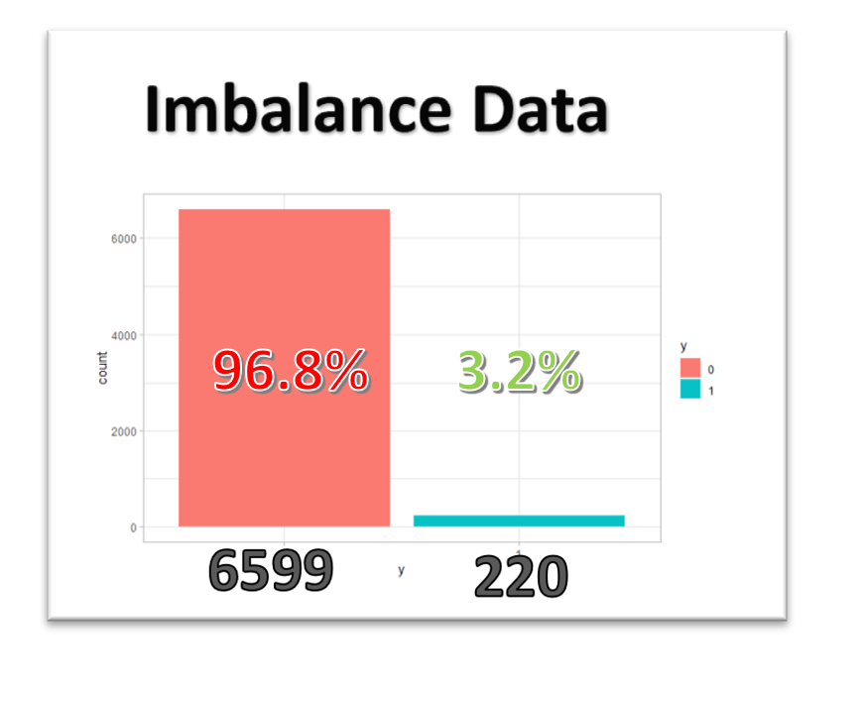
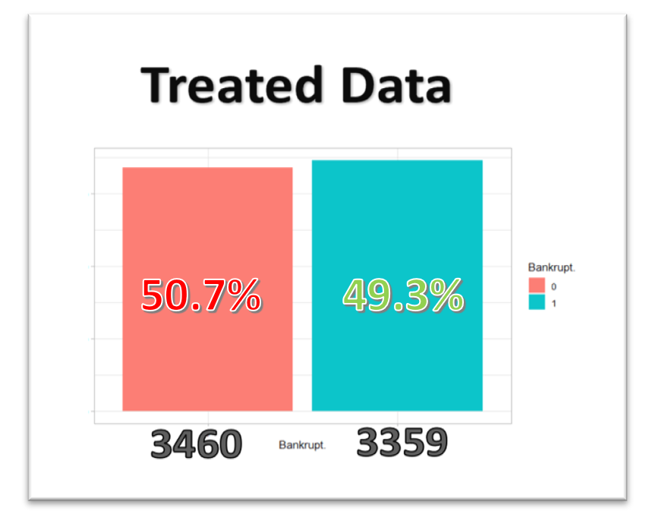

Data Processing
Bankrupt data is imbalanced!!
Data:
Taiwan Economic Journal
for the year 1999 to 2009
Source of data: UCI Machine Leaning Repository
Data Structure:
6819 observations
95 features
Treat imbalance with ROSE
Bankrupt = 0 or 1
(Randomly Over Sampling Example)
(Learning vector Quantization)
ECON 412 Final Project: Bankruptcy Prediction

Slide 5
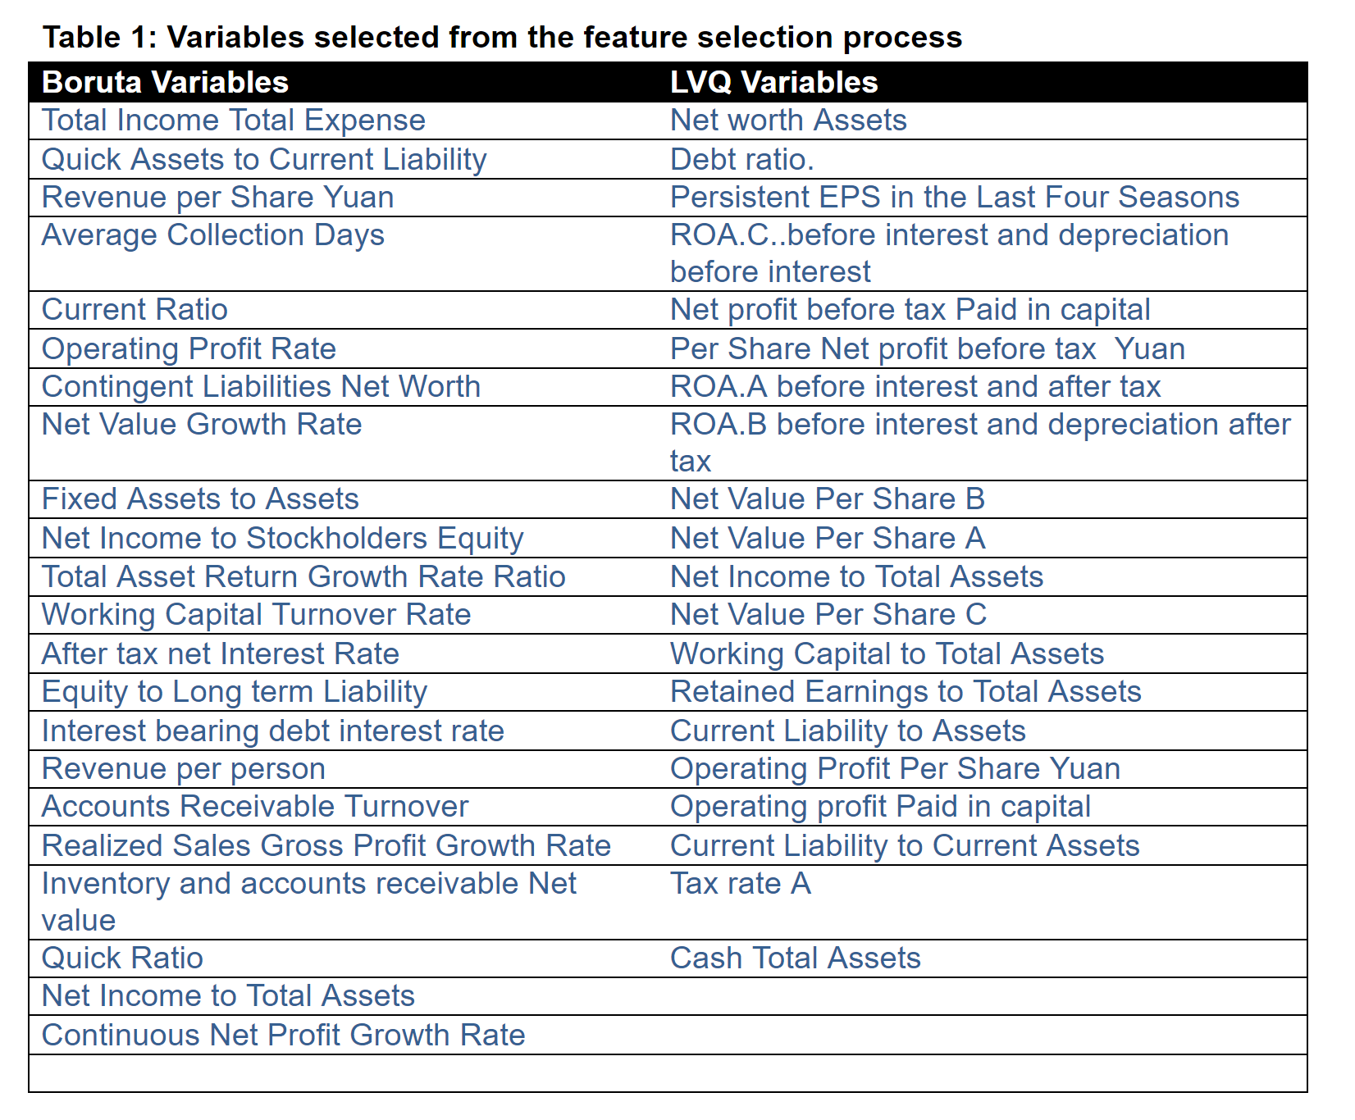
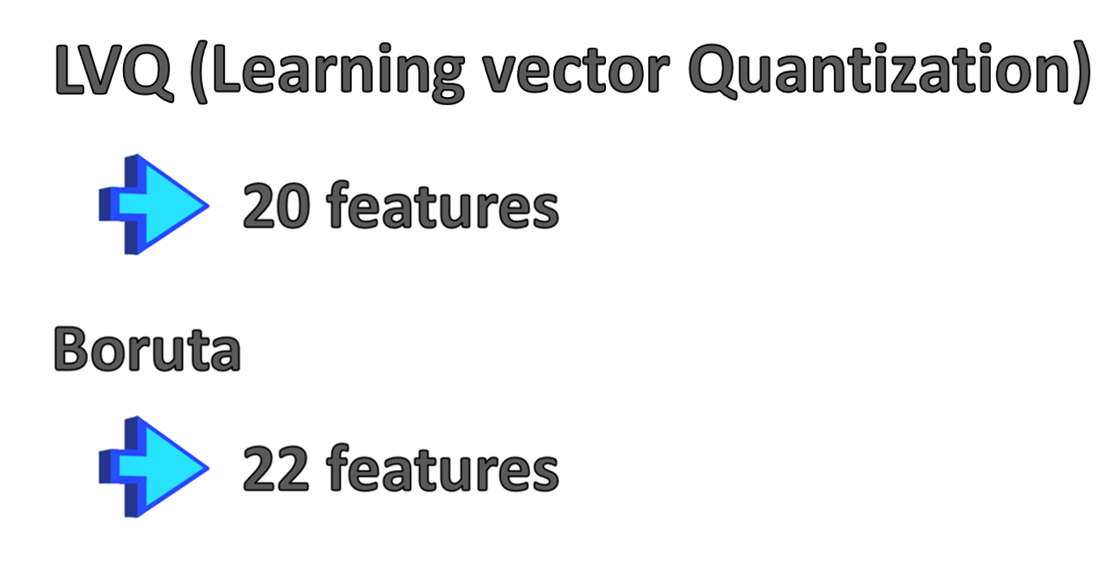
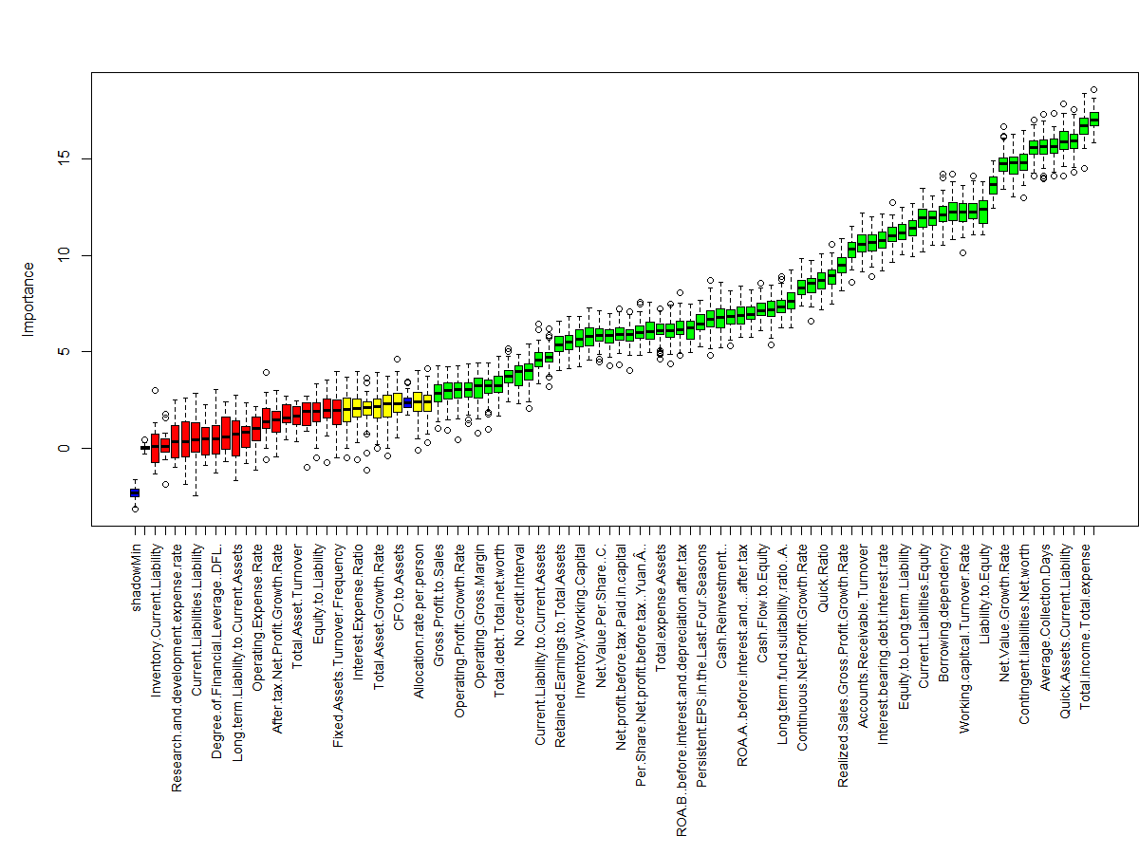
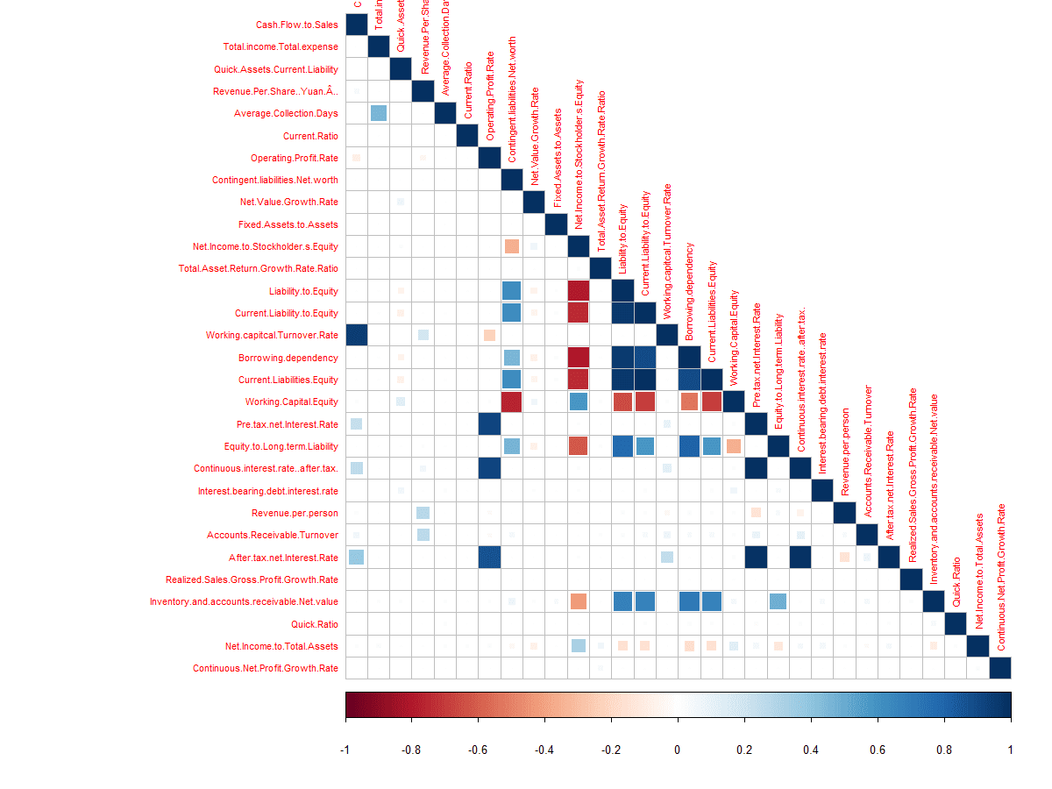
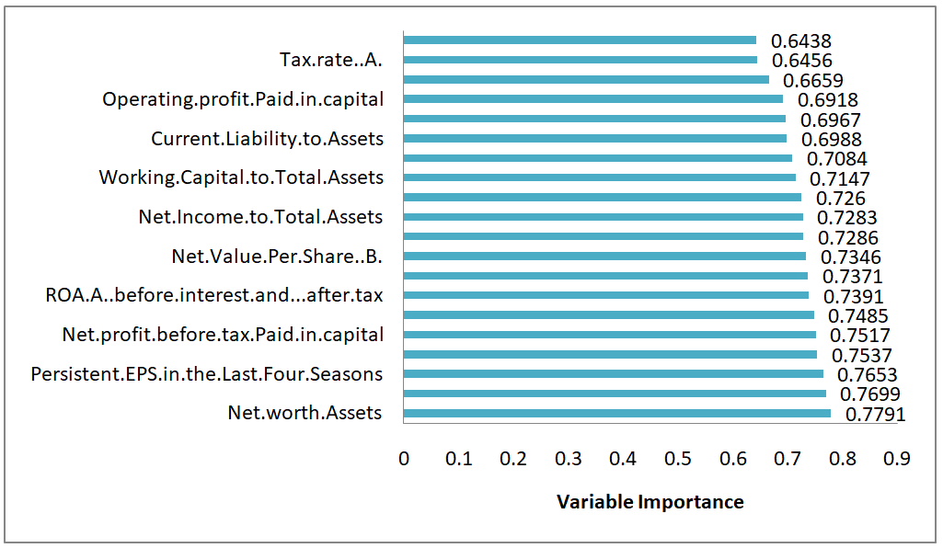

Feature Selection
Boruta
LVQ (Linear Vector Quantization)
Machine Leaning Models
ECON 412 Final Project: Bankruptcy Prediction

Slide 6


Machine Learning Models
4 models for two data sets
Logistic Regression
LVQ
Support Vector Machine (SVM)
Boruta
K-nearest Neighbors (KNN)
Quadrant Discriminant Analysis (QDA)
ECON 412 Final Project: Bankruptcy Prediction

Slide 7
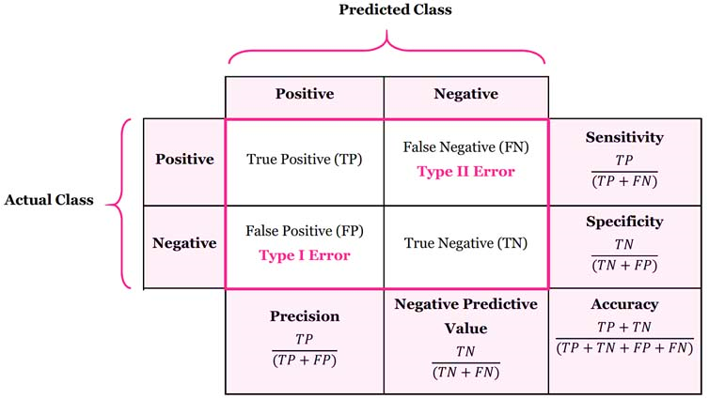
Model Comparison
Confusion Matrix
Accuracy
Boruta
LVQ
= out of all the predicted value,
how many of them are true
Model | Accuracy | Sensitivity | Specificity
Logistic | 0.5333 | 0.1379 | 0.9295
KNN | 0.6345 | 0.6075 | 0.6615
QDA | 0.5117 | 0.033 | 0.9874
SVM | 0.6565 | 0.6974 | 0.6155
Model | Accuracy | Sensitivity | Specificity
Logistic | 0.8126 | 0.7641 | 0.8647
KNN | 0.8603 | 0.8625 | 0.8502
QDA | 0.8607 | 0.8913 | 0.8322
SVM | 0.8592 | 0.8944 | 0.8214
Sensitivity
= how much of the predicted positive
is the true positive
Specificity
= out of all the predicted negative value,
how many of them are true negative
ECON 412 Final Project: Bankruptcy Prediction

Slide 8
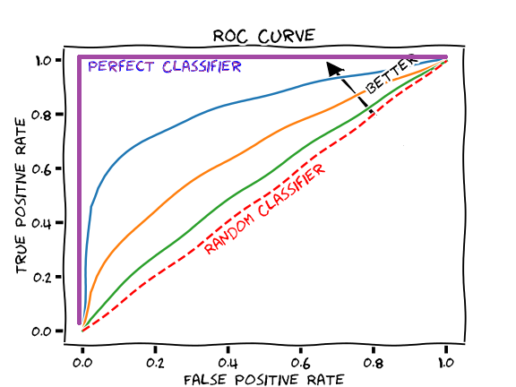
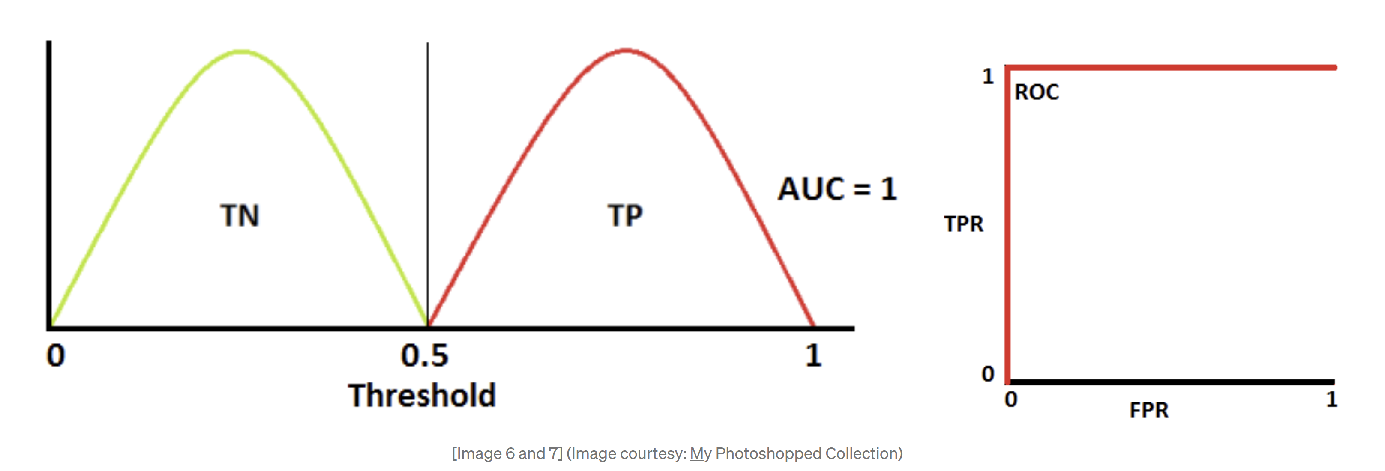
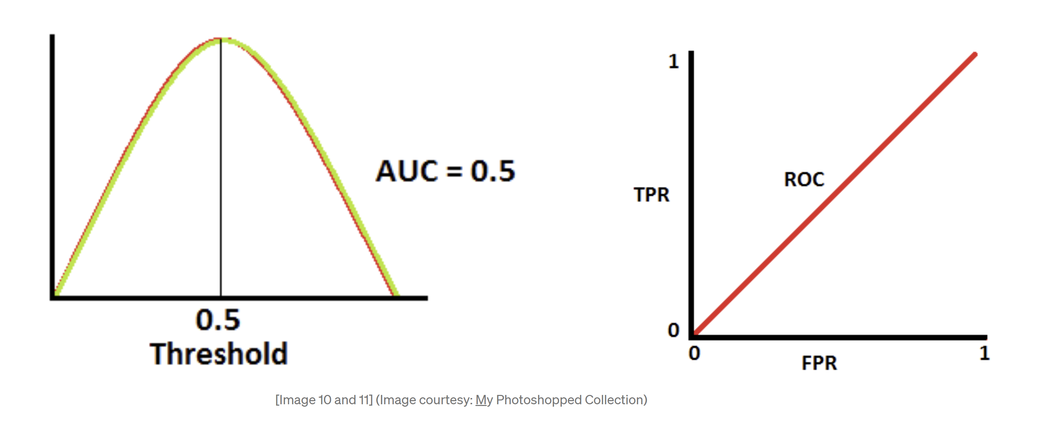
Model Comparison
Receiver Operating Characteristics (ROC)
Boruta
ROC = probability curve
LVQ
Model | AUC
Logistic | 0.590
KNN | 0.635
QDA | 0.634
SVM | 0.658
Model | AUC
Logistic | 0.816
KNN | 0.861
QDA | 0.862
SVM | 0.861
AUC (Area under the Curve)
= data separability
Higher the better (0 to 1)
ECON 412 Final Project: Bankruptcy Prediction

Slide 9
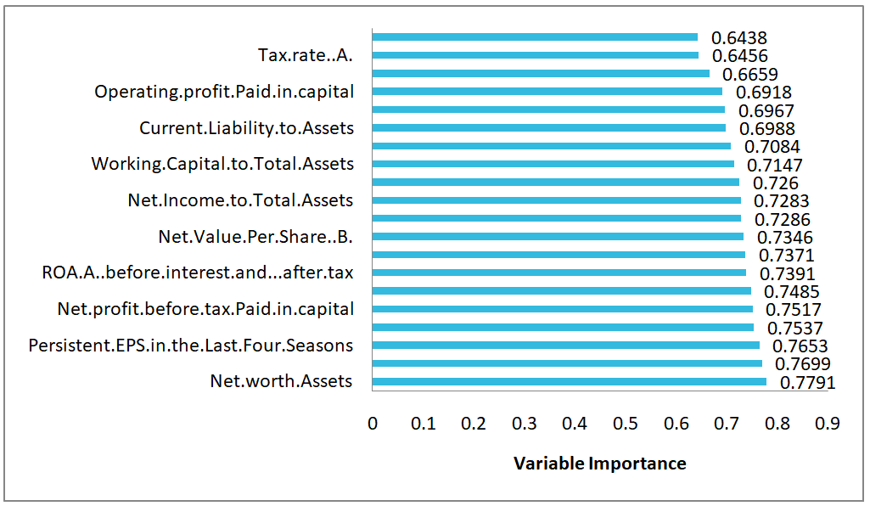
Summary
1. Obtaining a model with high accuracy
For Boruta, SVM with 65.8%
For LVQ, QDA with 86.2%
2. Find the key indicators
LVQ > Boruta, Ɐ ML models
LVQ Variable Importance
ECON 412 Final Project: Bankruptcy Prediction

Slide 10

Lastly…
ECON 412 Final Project: Bankruptcy Prediction

